Slide 1
THE TISSUE ISSUE

Slide 2
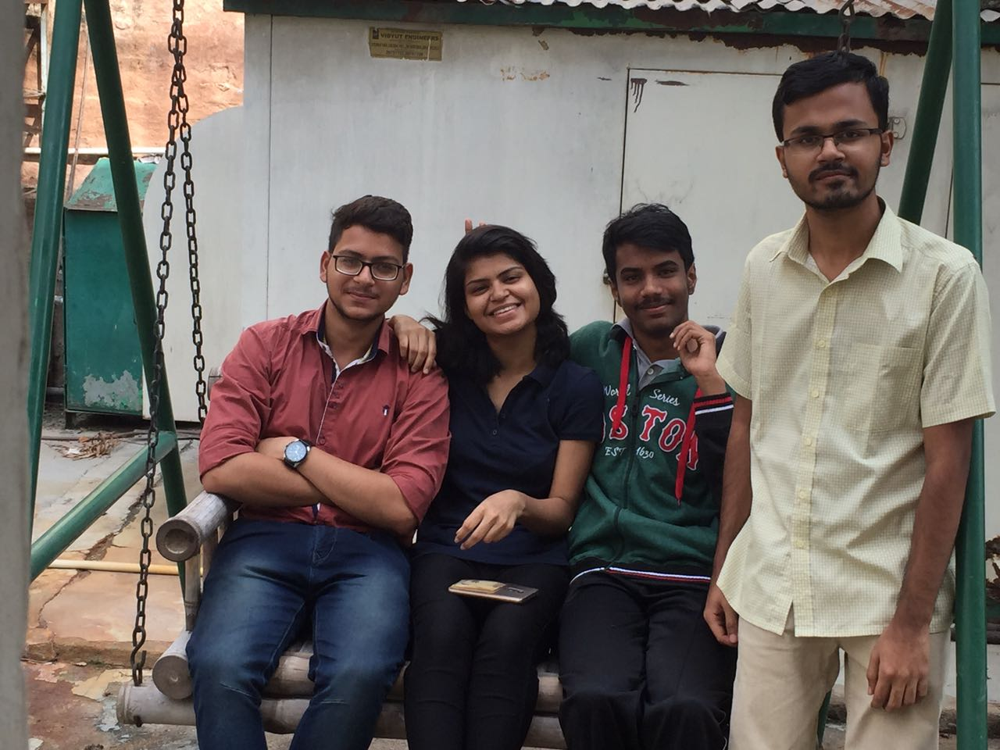
The Squad
Sonali Jha- Leader
Shubham
K.G.Indresh
S Pavishnu

Slide 3
PROBLEM STATEMENT
Usage of toilet paper leading to depletion of the tree cover.

Slide 4
The 6 Thinking Hat Approach
Usage of toilet papers leads to excess cutting down of trees, finding a way out of this situation is essential.
Global toilet paper production consumes 27,000 trees daily

Slide 5
Substituting cloth for paper Recycling used cloth to serve the purpose of the toilet paper
Help reduce deforestation
Cut Down the problem of Global Warming
Colourful toilet papers

Slide 6
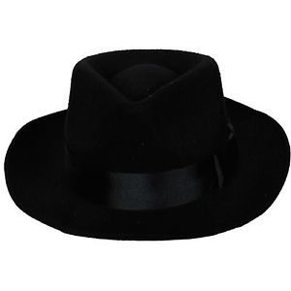
Adaptation will be a challenge
Higher investments comparatively
The World would be a better place to live.

Slide 7
IMPLEMENTATION
Collecting used clothes from households
Categorizing the collected clothes by material
Cut out uniform sized pieces of the cloth
Clean and Condition the cloths
Packaging and sale

Slide 8
BUSINESS VALUE
It will revolutionize a very simple day to day usage
Saving trees is one of the major concerns of the world today
Recyclable

Slide 9
Financial Help
Companies to be targeted:
P&G
Hindustan Unilever
Microsoft

Slide 10
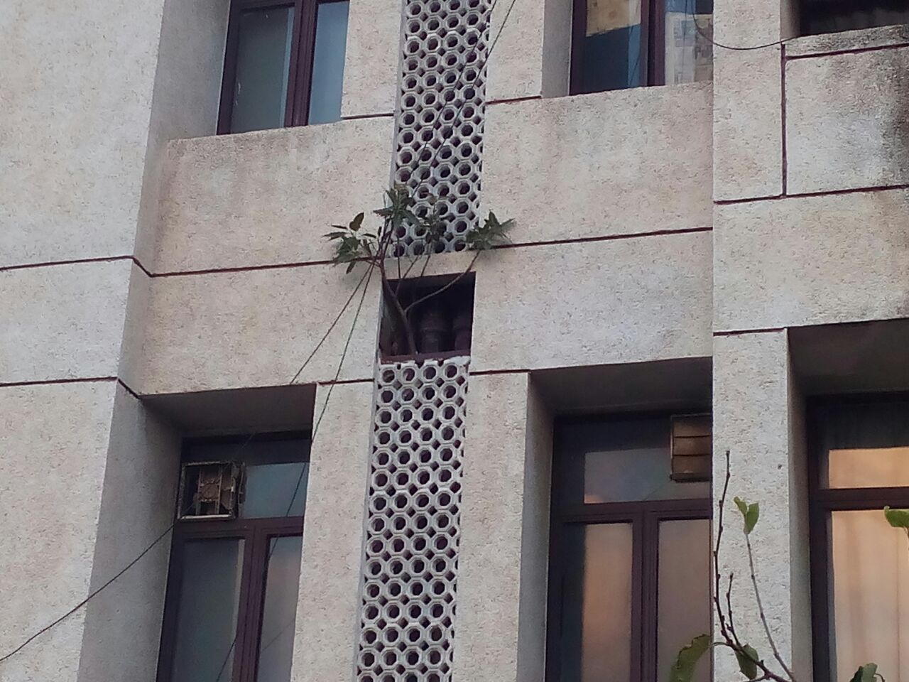
Thank You!
Any Questions?

